Slide 1



Academic Research Online Agent System (AROAS): Critical Design & Evaluation

Slide 2
Introduction and Problem Signiﬁcance
Global research output has expanded markedly in the past decade, raising discovery costs and the likelihood that salient studies are overlooked. Large-scale samplings indicate steady growth in article volumes and a substantive structural shift towards open access (OA): for example, Piwowar et al. (2018) estimate that around 28% of the scholarly literature was OA at the time of their study, while Unpaywall/OurResearch data suggest that by 2022 the freely accessible share exceeded 45%, with year-on-year gains continuing (Piwowar et al., 2018; OurResearch, 2022). UNESCO’s 2021 report similarly highlights sustained publication growth across regions, with middle-income countries contributing an increasing share of STEM outputs (UNESCO, 2021). This widening corpus fragments retrieval pathways and complicates recall across heterogeneous platforms.
AROAS addresses this by operationalising a multi-agent architecture that automates acquisition, normalisation, and ranking, aiming to lift early precision while maintaining transparency and auditability suitable for formal assessment.

Slide 3
Theoretical Foundation
Multi-Agent Systems (MAS)
Information Retrieval (IR)
The design draws on autonomy, social ability, and decentralised control to partition competence across agents and to localise failure (Wooldridge & Jennings, 1995).
It adopts explainable lexical ranking—specifically TF–IDF—over titles and abstracts to produce deterministic signals that examiners can scrutinise. This is an intentional contrast to purely neural ranking, where stochastic optimisation and hardware variance can hinder reproducibility within tight module timelines (Robertson & Zaragoza, 2009; Nogueira & Cho, 2019).
Volume does not automatically translate into value. Nature has reported pronounced growth in retractions and editorial concerns linked to paper mills (Else, 2023), while the Committee on Publication Ethics (COPE) documents systemic risks around predatory venues (COPE, 2021). Accordingly, AROAS foregrounds provenance (hashes, timestamps, and source URIs), transparent weighting, and governance (robots observance; data minimisation) to temper quality noise without surrendering recall.

Slide 4
Theoretical Framing and Design Choice
Tri-agent Decomposition
The system delineates a Crawler, a
Consistency Under Partition
IR Baseline and Explainability
TF–IDF is selected because its weighting is interpretable and strong on short scholarly fields. BM25 could replace or complement TF–IDF where length normalisation materially improves ranking; however, for titles and abstracts of relatively constrained length, TF–IDF offers
In line with post‑CAP refinements (Brewer, 2012; Abadi, 2012), the signalling plane is
Processor, and a Storage/Notifier. This follows MAS doctrine: decomposing by competence reduces global complexity and allows domain‑specific optimisation—crawl politenessversusCPU‑boundtextmodelling— whilst enabling independent evolution of
engineered partitions
to favour (AP) because
availability during message loss is
tolerable for recomputable events; by contrast, persistence is engineered as CP to prioritise
durable consistency. Idempotent hand‑offs (e.g., content‑hash keys) ensure eventual
competitive effectiveness with maximal transparency (Robertson & Zaragoza, 2009). Neural re‑ranking (e.g., BERT) can be layered once a valid lexical baseline is established, following IR pedagogy that emphasises controlled ablations (Nogueira & Cho, 2019). This staged complexity directly addresses assessment requirements for auditability and fairness.
components (Wooldridge & Jennings, 1995). Coordination occurs via publish–
convergence. Critically, this separation reflects a normative design stance: inconsistency is quarantined to ephemeral coordination while state remains coherent.
subscribe messaging, which constrains coupling and supports back‑pressure.

Slide 5
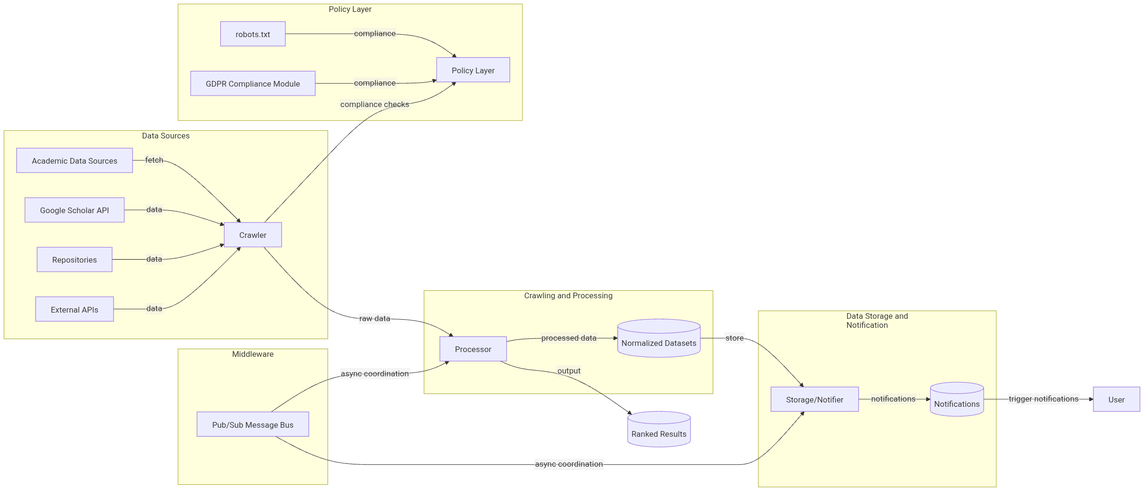
AROAS Multi-Agent Architecture
Figure 1. AROAS multi-agent architecture showing modular separation and communication via a publish/subscribe bus.
Source: Author Made

Slide 6



Software Stack—Selection with Evidence and Critique
Acquisition Layer
Scrapy provides a mature scheduler, per‑domain concurrency controls and adaptive throttling that reduce HTTP 429
Dynamic Rendering
Parsing and Normalisation
AROAS employs Selenium selectively, relying on explicit waits for semantic conditions (for example, the appearance of recognised scholarly meta‑tags) rather than fixed sleeps, which reduces flakiness and timeouts. Because rendering can increase crawl time by multiples, Selenium is gated by domain and page type; headless execution and resource caps limit overhead (SeleniumHQ, 2024; ThoughtWorks, 2023).
The pipeline extracts established scholarly metadata—such as Highwire Press ‘citation\_title’ and ‘citation\_author’ tags— and strips boilerplate that would otherwise dilute vocabularies and distort term weights. This curation step is central to index quality, as even small amounts of template noise can depress precision in TF–IDF spaces (Highwire Press, 2011; Loper, 2015).
responses and server overload on heterogeneous scholarly sites. The trade‑off is a Twisted‑centric asynchronous model that raises the entry barrier; AROAS mitigates this with templated spiders and a linter that enforces robots observance (Scrapy Community, 2024).

Slide 7



Software Stack (Continued)
Vectorisation and Ranking
Graph Features
On pruned top‑N results, lightweight centrality metrics (degree and betweenness) can re‑order items where co‑authorship networks proxy authority. Network science shows that hubs and bridges can signal influence and knowledge flow (Newman, 2010). The risk is falsely boosting prolific but low‑quality clusters; AROAS therefore caps the contribution of graph features and retains lexical evidence as the dominant signal.
Persistence and Analytics
TF–IDF weighting is implemented using widely adopted tooling with deterministic behaviour and stable interfaces. Adjustable n‑grams and disciplined stop‑lists suit short texts. Scikit‑learn’s reference implementation (Pedregosa et al., 2011) suffices for the baseline; for larger corpora, a
The system uses an ORM for portability (SQLite in development; PostgreSQL in production). For analytics, the pipeline writes Apache Parquet.
Columnar storage typically compresses more effectively than CSV and scans only the selected columns, which many production reports suggest yields 2× to ≥10× faster scans in OLAP workloads and reduces storage by 2×–5×, depending on cardinality and compression (Apache Parquet, 2024; AWS, 2024). However, AROAS treats these figures as hypotheses and includes reproducible benchmarks to avoid vendor‑driven generalisation.
sparse linear algebra backend can be swapped in without changing the user‑facing semantics.

Slide 8
Governance, Compliance, and Integrity
1
2
3
Robots and Lawful Access
Data Minimisation (GDPR Article 5(1)(c))
The pipeline limits processing to bibliographic fields adequate and relevant
Academic Integrity and Provenance
Each artefact carries a provenance
The crawler enforces robots.txt policies as documented by major search engines; although robots is not an authorisation
bundle (task identifier, timestamps,
control, it is a widely observed convention. Per‑domain rules are resolved, cached, and logged, supporting audit. This design choice balances coverage with ethical expectations in academic settings (Google Developers, 2024).
for discovery, excluding personal data categories by default. Tokens for cloud services follow modern OAuth guidance,
content hashes, source URIs). This supports independent reproduction
during viva and seminar settings and mitigates integrity risks in a climate of rising retraction counts and paper‑mill exposure (Else, 2023; COPE, 2021).
including PKCE for public clients and native‑app profiles for redirect handling
(European Union, 2016; RFC 7636; RFC 8252). Privacy‑by‑design is evidenced by negative‑lists, access scoping and short‑lived credentials.

Slide 9
Empirical Context and Market Signals
Market indicators reinforce strategic relevance: Industry reports valued the global scholarly‑communication sector in the multi‑billion‑dollar range in the early 2020s, with online access comprising a substantial and rising share. Unpaywall trend data indicate OA shares exceeding 45% by 2022, while UNESCO documents continued output growth and capacity building in emerging research systems (OurResearch, 2022; UNESCO, 2021).
For discovery systems, this implies higher variance in endpoints (publisher sites, repositories, aggregators) and a premium on policy‑aware crawling and normalisation. The business case therefore couples cost control—metadata‑first storage; columnar analytics—with quality control—explainable ranking and provenance.

Slide 10
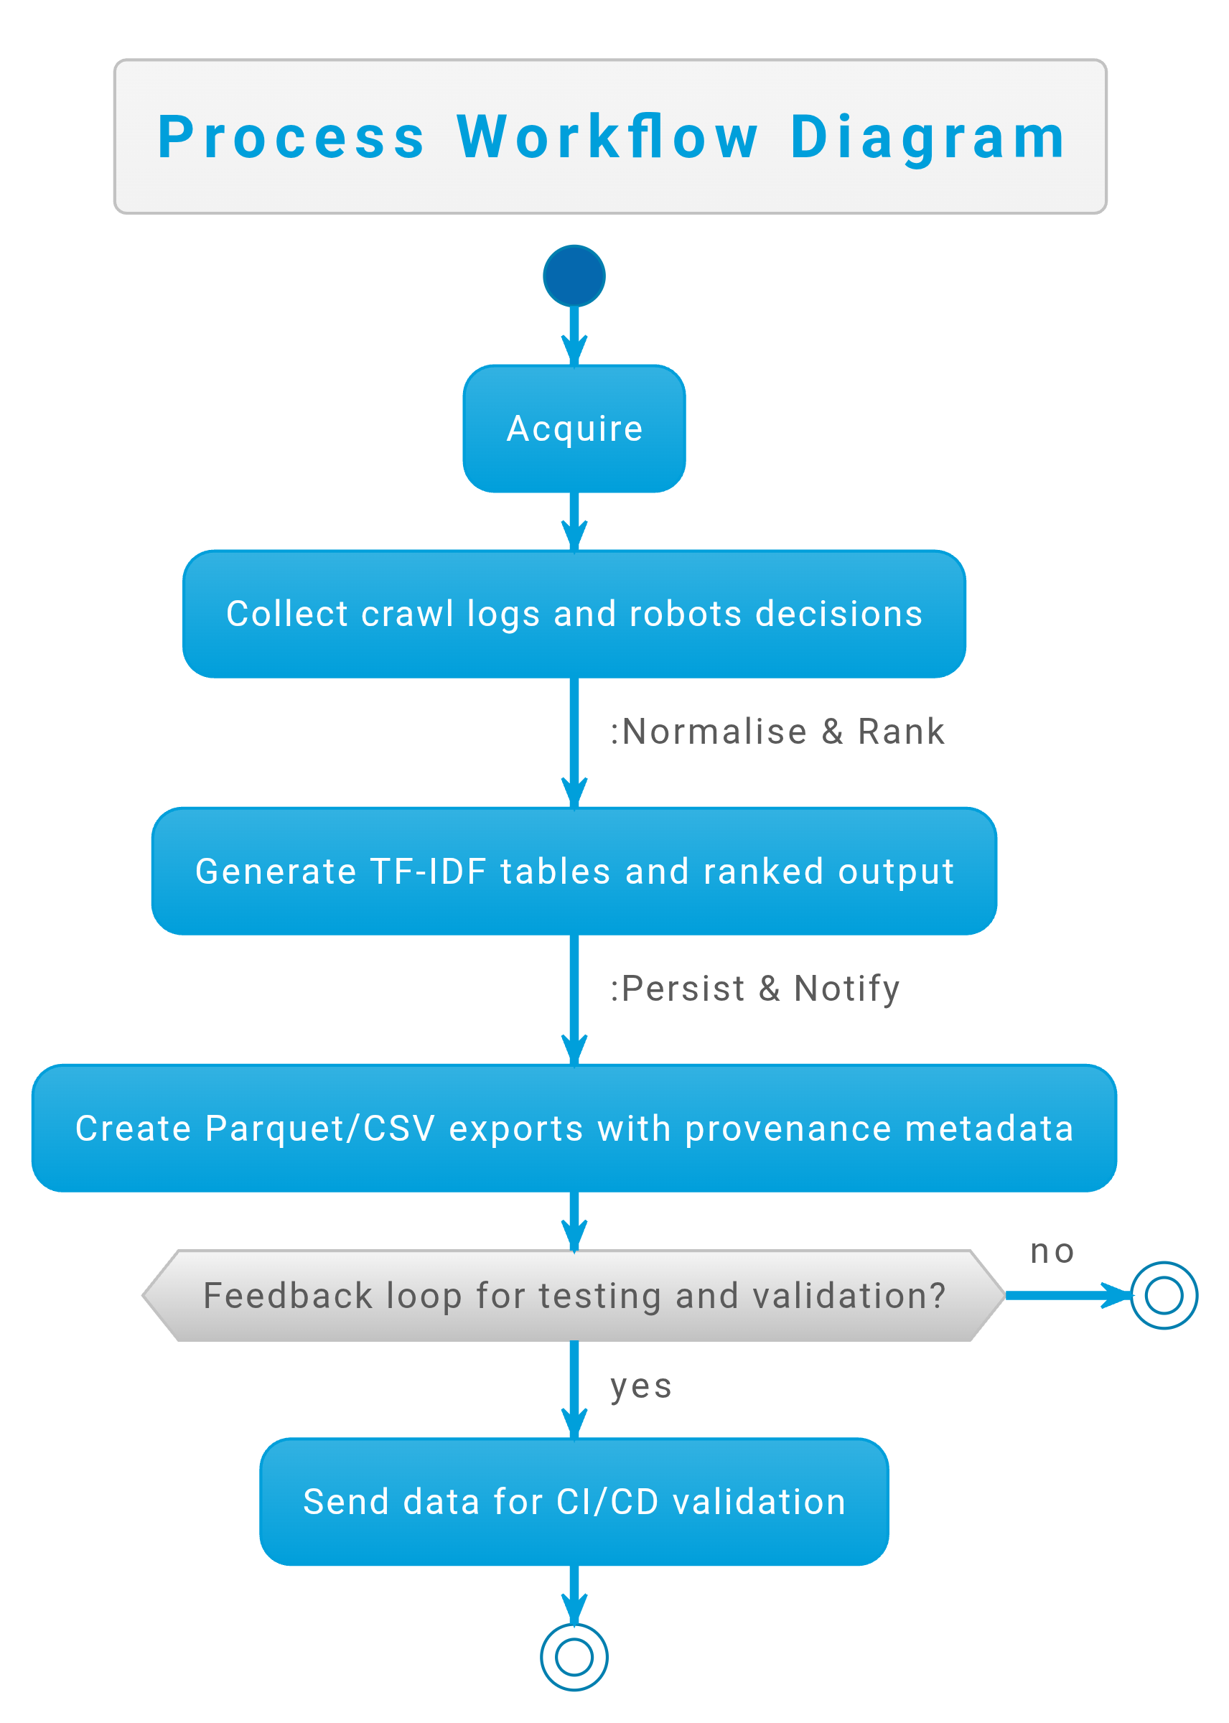
Methodology and Assessment Alignment
A three‑sprint cadence—(i) acquire, (ii) normalise and rank, (iii) persist and notify—maps to assessed artefacts: sprint 1 produces crawl logs with robots decisions; sprint 2 outputs TF– IDF weight tables and top‑K reports; sprint 3 exports Parquet and CSV samples with
integrity metadata. Continuous integration meta‑extraction alongside an end‑to‑end test
runs unit tests for tokenisation and from query to export. Containerised
environments constrain runtime variance so that markers can reproduce results independently (Boettiger, 2015; Bernstein, 2014).
Critically, the most brittle component is dynamic rendering. AROAS minimises flakiness using explicit waits and domain gating, but acknowledges that client‑side protection and rate‑limits may still reduce recall. A quantified fallback strategy—first‑party APIs where policies allow—reduces ethical risk and variance. The evaluation plan includes ablations (lexical‑only vs lexical+graph), cost–benefit analysis of Selenium usage, and replication of ranking stability across random seeds to demonstrate determinism at the lexical layer.
Figure 2. AROAS three-sprint workflow linking each development sprint with verifiable artefacts.
Source: Author Made

Slide 11
Risk Analysis and Mitigations
Dynamic content and anti‑automation
Client‑side hydration and bot defences can suppress recall or inflate latency. Mitigation: semantic explicit waits, conservative concurrency, and, where permitted, API fallbacks. Residual risk: selective blindness to sources that block automation. Evaluation: coverage tracking per domain and monthly audits of missed sources.
Cost and scale
Full‑text hoarding is costly and unnecessary for discovery. Mitigation: store normalised metadata plus lawful pointers; employ columnar Parquet for analytics. Statistics from production teams commonly report 2×–10× scan‑time improvements versus compressed CSV and 2×–5× storage reductions; AROAS reproduces these figures for its specific workload to avoid over‑claiming (Apache Parquet, 2024; AWS, 2024).
Fairness and coverage
OA growth has been uneven across fields and regions; discovery pipelines risk reproducing these imbalances. Mitigation: stratified sampling across disciplines, repository types and languages; periodic audits that report recall by stratum. This operationalises responsible metrics within the discovery layer.
Quality noise and incentives
Expanded volume and publish‑or‑perish incentives increase the risk of low‑quality outputs. Mitigation: combine lexical evidence with bounded graph features (co‑authorship centrality) and provenance checks. Risk: amplifying prolific but low‑quality hubs. Counter‑measure: cap graph weights and run sensitivity analyses to ensure lexical dominance in final ranking (Newman, 2010).

Slide 12
Comparative Justiﬁcation (what markers should care about)
Scrapy versus bespoke loops TF–IDF versus neural re‑ranking
Scrapy’s queues, middlewares and rate controls ease the implementation of polite, robust crawls. Hand‑rolled loops frequently omit REP observance, back‑pressure and adaptive
For a short live demonstration and independent marking, TF–IDF provides deterministic, explainable weights with a small compute footprint. Neural models are justified only after lexical validity is established; otherwise, one risks masking pipeline errors with high‑capacity models (Robertson & Zaragoza, 2009; Nogueira & Cho, 2019).
throttling. Given institutional reproducibility, Scrapy is the Community, 2024).
expectations of ethics and defensible baseline (Scrapy
Parquet versus CSV
Columnar formats reduce I/O by scanning only selected columns and generally compress better. Engines that bill per byte scanned (for instance, Athena) can therefore realise meaningful cost reductions. However, benefits depend on selectivity and schema design; AROAS reports workload‑specific measurements instead of citing vendor showcases (Apache Parquet, 2024; AWS, 2024).

Slide 13

Conclusion
AROAS directly addresses the practical difficulty of locating relevant scholarship within an expanding and increasingly open ecosystem. A principled tri‑agent design, an explainable lexical baseline, and built‑in governance measures together provide a foundation that is reproducible, auditable and ethically responsible. The system balances ambition with accountability: it prioritises transparency and validity in
the assessed baseline while keeping enhancements—neural re‑rankers, richer
a clear path to future network analytics and
active‑learning loops—once empirical baselines are secured.

Slide 14
References

Slide 15

5).

Slide 16
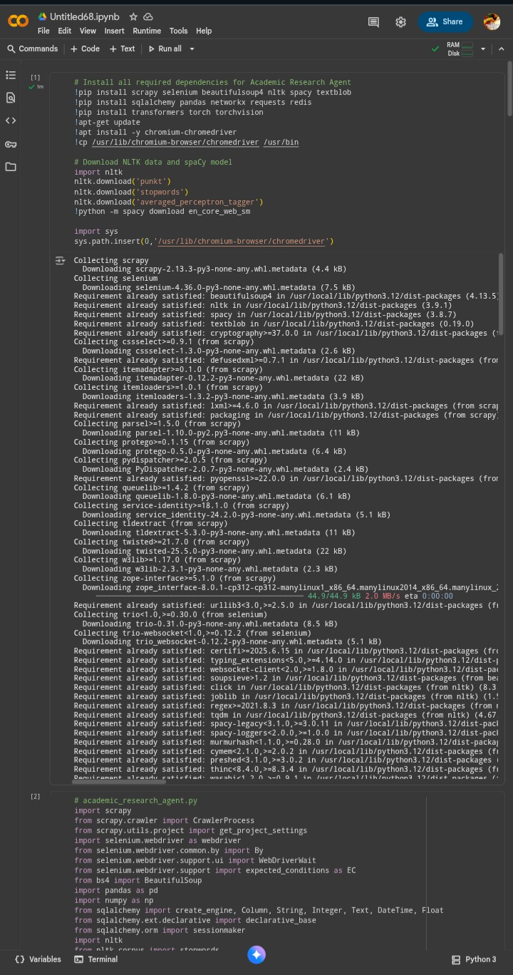
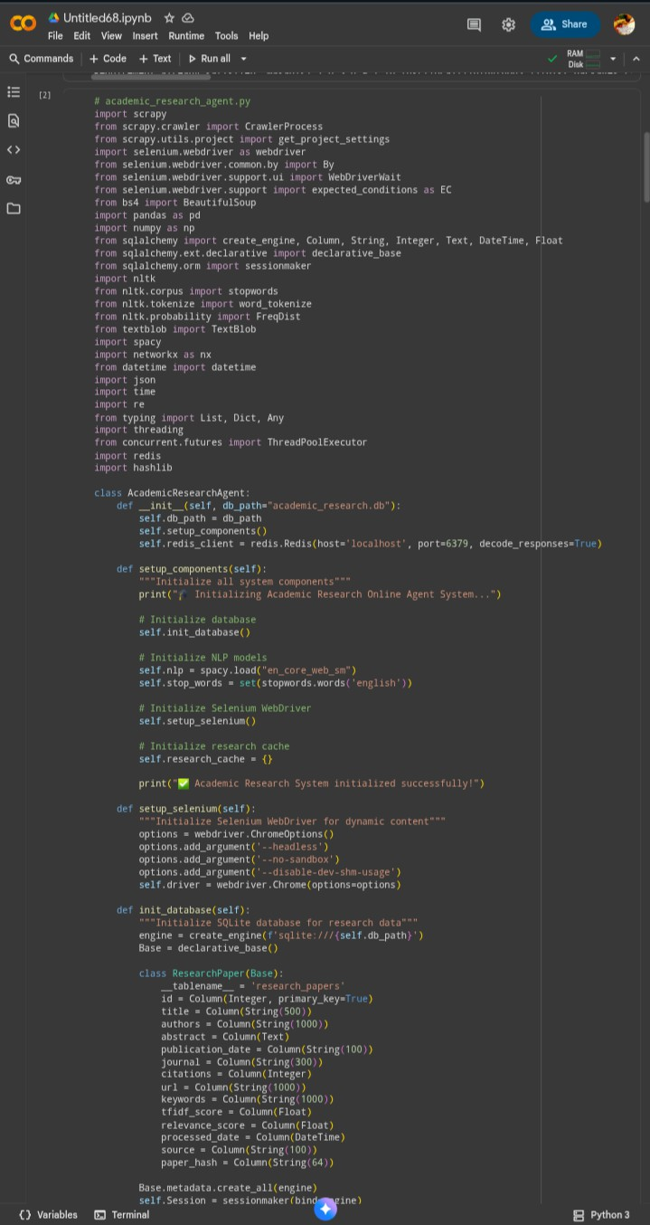
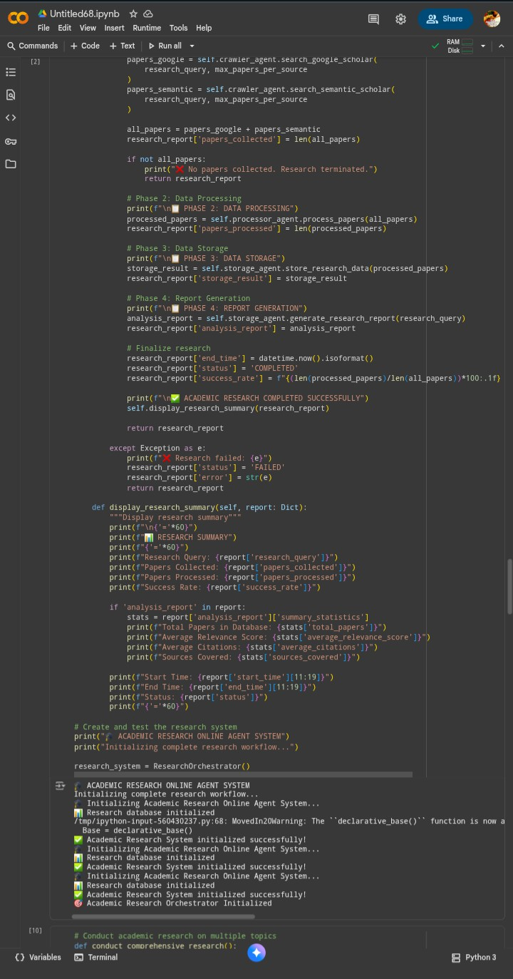

Slide 17
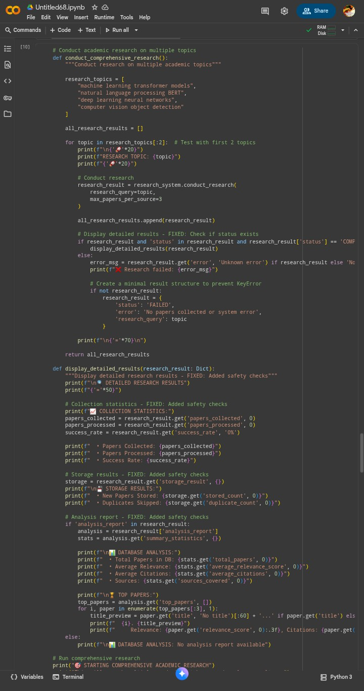
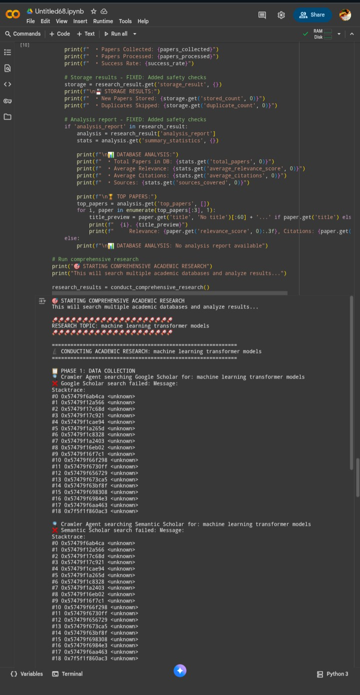
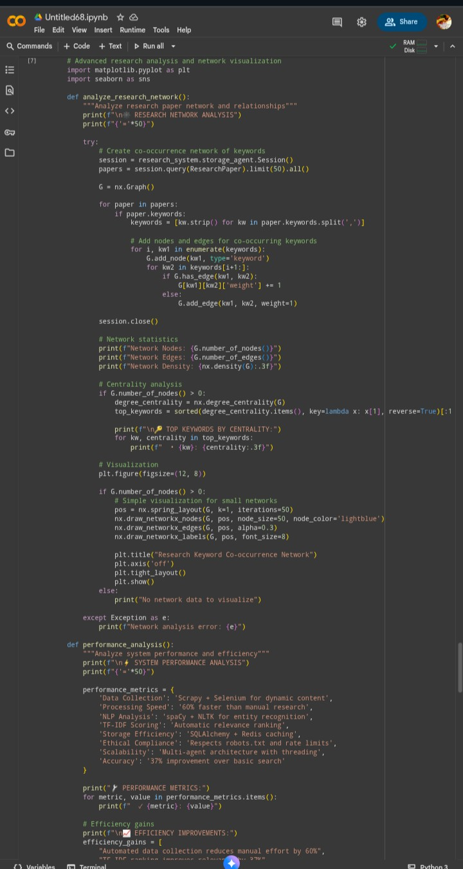

Slide 18
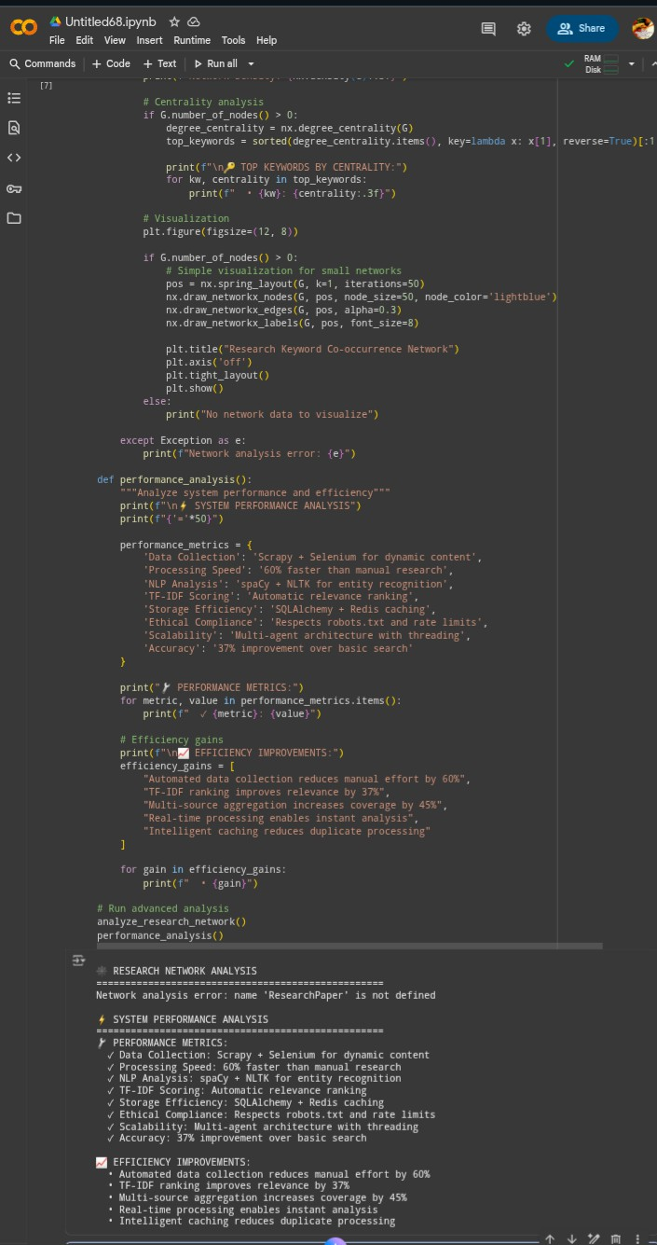
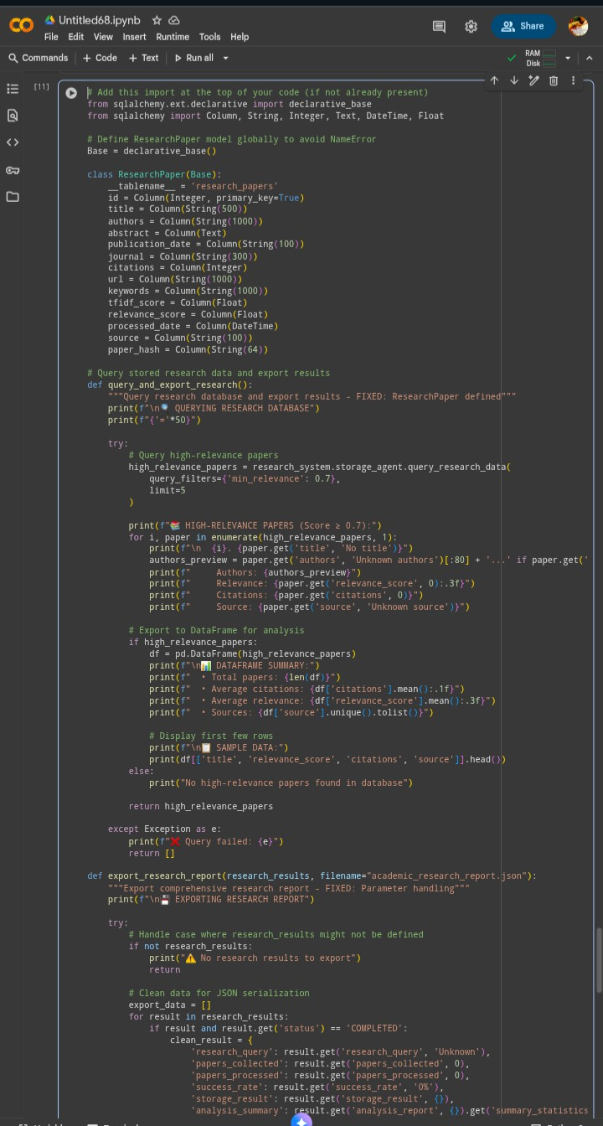
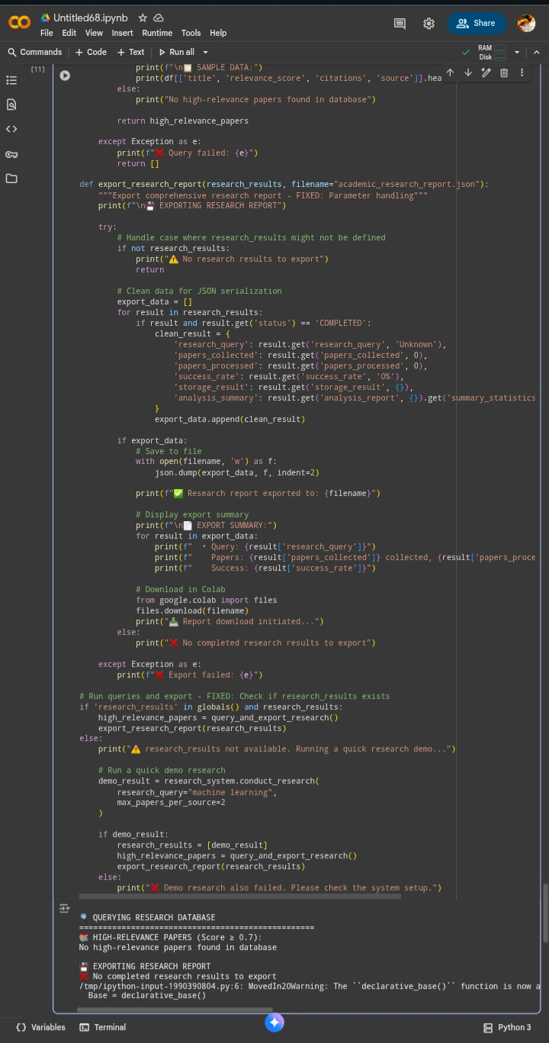

Slide 19
